Slide 1
Network Routing Optimization
By: Steven Crocker, Bryce Lander, Ricky Newbold
CSC 2400

Slide 2
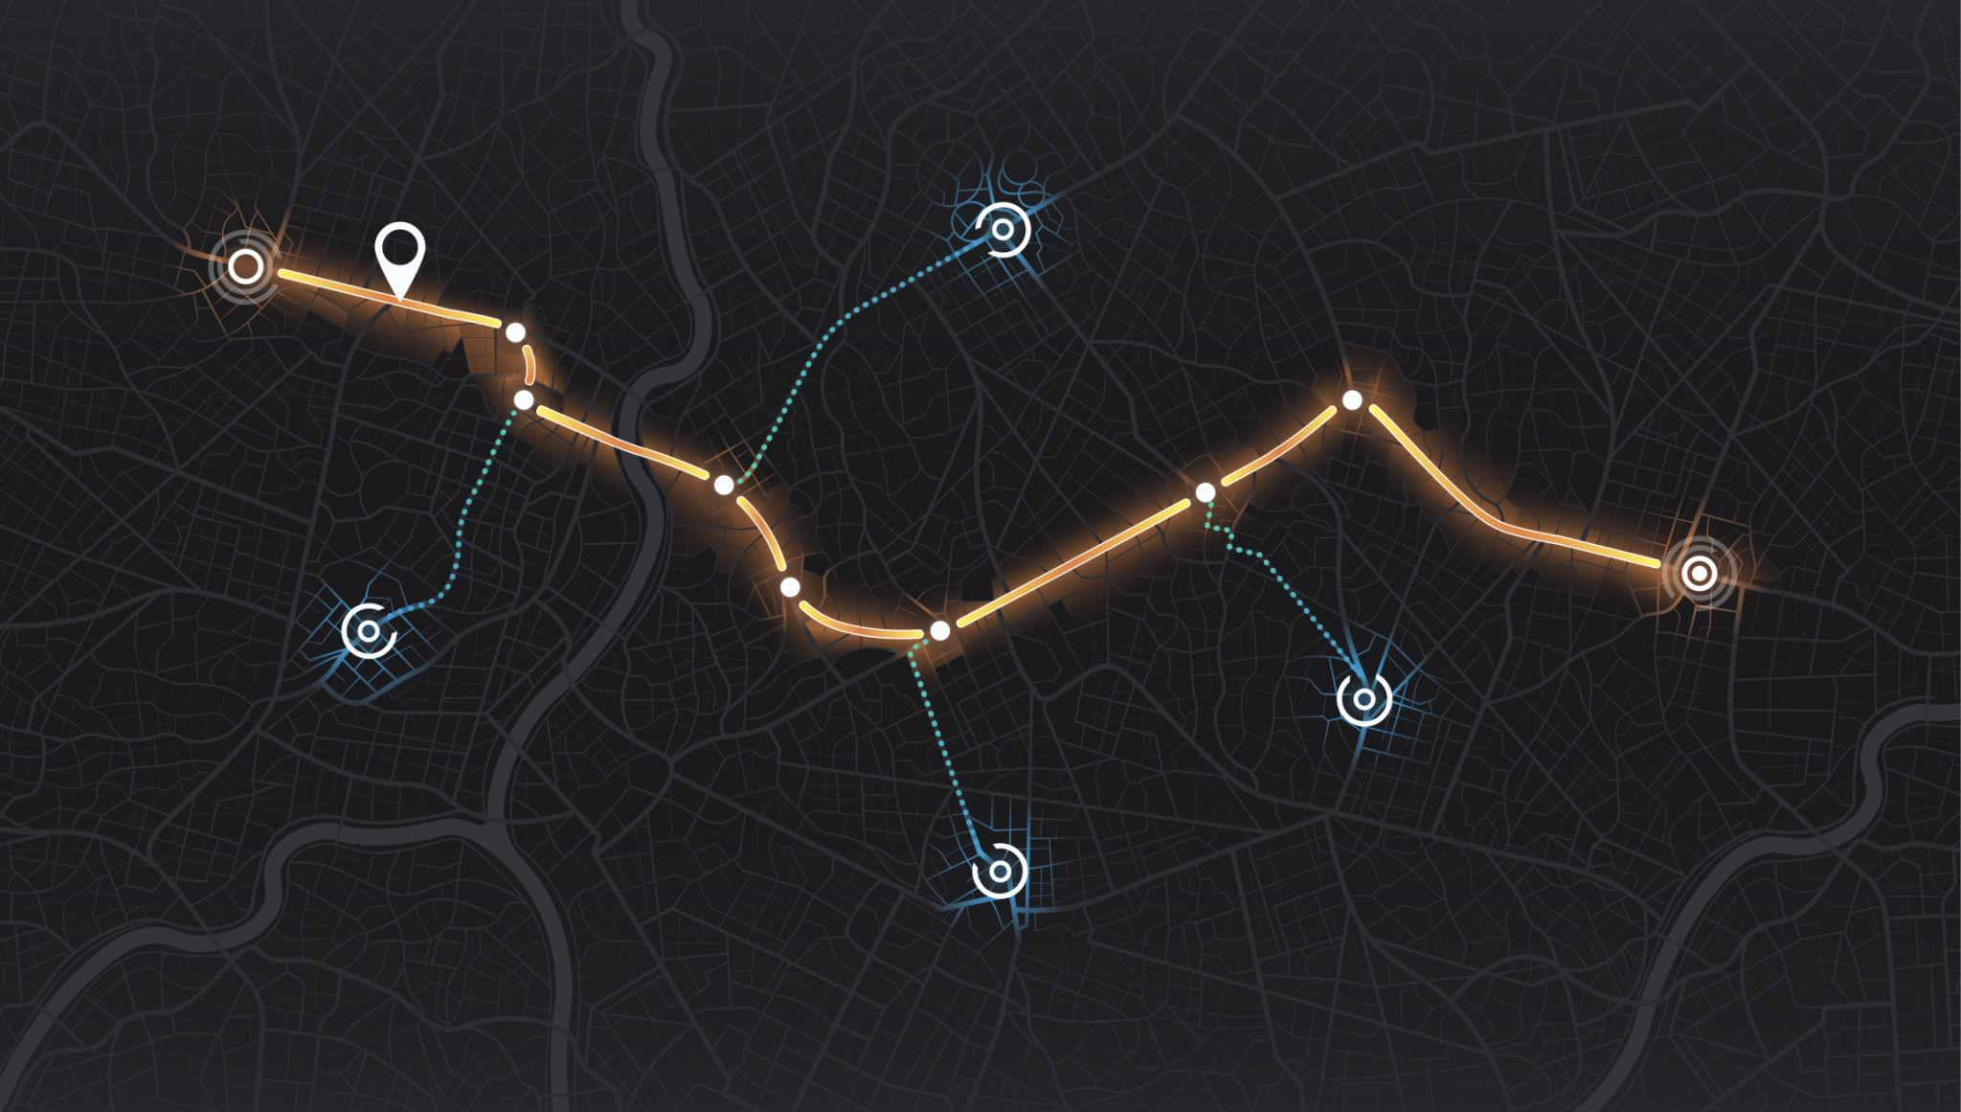
Background
This project looks at how a GPS system determines routes and how different algorithms can affect that process. We modeled real-world road networks and used several routing approaches to simulate how paths are calculated between locations. By testing this across different cities, we were able to observe how each method performs and how road layout can influence the results.

Slide 3
Dijkstra’s Algorithm
Published in 1959 by Edsger W. Dijkstra.
An algorithm for finding the shortest paths between nodes in a weighted graph.
Keeps a set of visited nodes and uses a priority queue to select the unvisited node with the smallest distance.
Guarantees a shortest path.
Worst case: Θ(|E| + |V| log|V|)

Slide 4
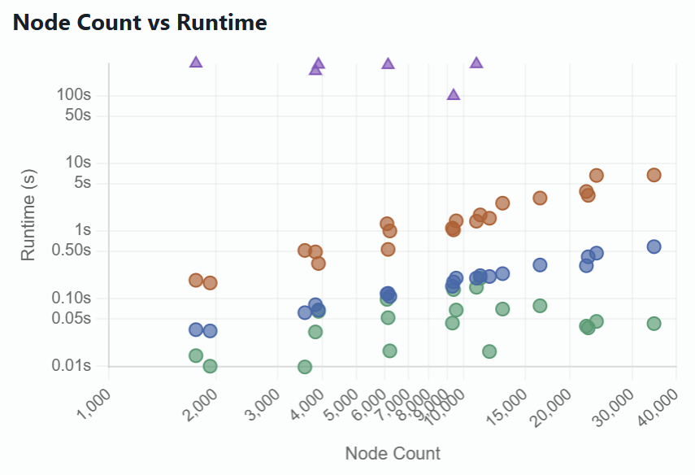
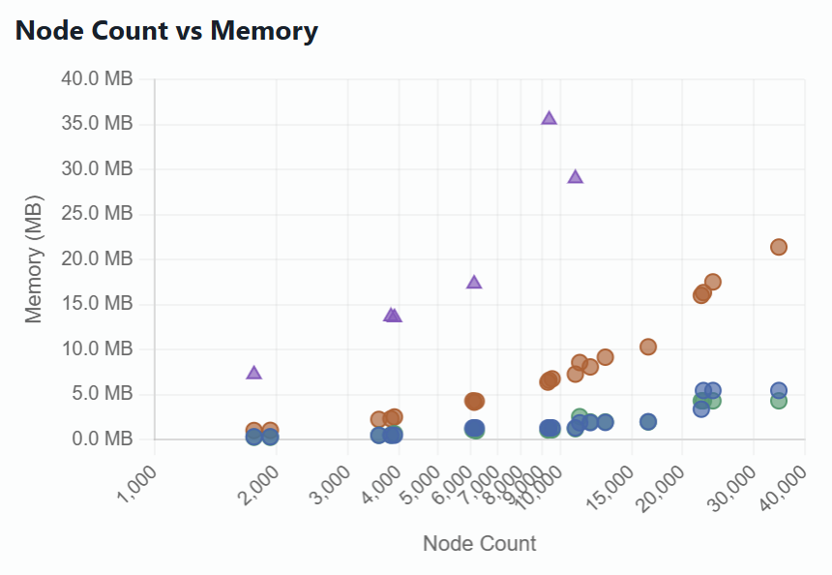
Dijkstra Data
In our GPS system, Dijkstra builds the route by expanding outward from the starting location and evaluating all nearby roads based on travel time. It continues exploring until it reaches the destination with the lowest total cost. This results in a consistent and reliable route that fully considers the road network.
Route
Input Size(n)
Runtime (seconds)
Memory Usage (Megabytes)
Asheville, NC
3902
0.0721
0.4943
Atlanta, GA
12919
0.2370
1.9153
Birmingham, AL
11170
0.2221
1.8740
Johnson City, TN
9210
0.0809
0.4927

Slide 5
A* Algorithm
Pronounced “A-Star”
Published as an extension of Dijkstra’s algorithm in 1968
Takes a weighted graph, source node, and goal node, then finds the shortest path
Used in many fields of computer science due to its completeness, optimality, and optimal efficiency
Worst Case: O(|E| log|V|)

Slide 6
A* Data
A* calculates routes by focusing the search toward the destination using both current travel time and an estimated remaining distance. This allows it to follow more direct paths across the map while still producing an optimal route. The result is a faster and more targeted route calculation.
Route
Input Size(n)
Runtime (seconds)
Memory Usage (Megabytes)
Asheville, NC
3902
0.0623
0.6614
Atlanta, GA
12919
0.0670
1.9694
Birmingham, AL
11170
0.1989
2.5426
Johnson City, TN
9210
0.0320
0.5089

Slide 7
Bellman-Ford Algorithm
Computes shortest paths from a single source vertex to all of the other vertices in a weighted graph
Named after Richard Bellman and Lester Ford Jr.
Slower than Dijkstra's algorithm, but it can handle negative weights
Worst Case: Θ(|V||E||)

Slide 8
Bellman-Ford Data
Bellman-Ford determines the route by repeatedly updating travel times across the entire network. It reevaluates all connections multiple times to ensure the final path is correct. This produces accurate results, but requires more computation to reach the final route.
Route
Input Size(n)
Runtime (seconds)
Memory Usage (Megabytes)
Asheville, NC
3902
0.3413
2.2947
Atlanta, GA
12919
2.4905
9.0311
Birmingham, AL
11170
1.8270
8.3373
Johnson City, TN
9210
0.4889
2.3260

Slide 9
Ant Colony Optimization Algorithm
A probabilistic technique for solving computational problems that can be reduced to finding good paths through graphs.
Inspired by the pheromone-based communication of real ants.
Artificial ants are used to represent multi-agent methods.
Usually combined with local search algorithms

Slide 10
ACO Data
ACO models routing based on how ants find paths using pheromones. Multiple ants explore different routes between the start and destination, and paths that perform better are reinforced over time with higher pheromone values. As this process continues, stronger paths become more likely to be chosen, allowing a route to gradually emerge. In a GPS context, this means the route is built through repeated exploration and learning rather than being calculated directly in a single step.
Route
Input Size(n)
Runtime (seconds)
Memory Usage (Megabytes)
Asheville, NC
3902
302.1908
13.5856
Atlanta, GA
12919
N/A
N/A
Birmingham, AL
11170
N/A
N/A
Johnson City, TN
9210
231.6754
13.6710

Slide 11
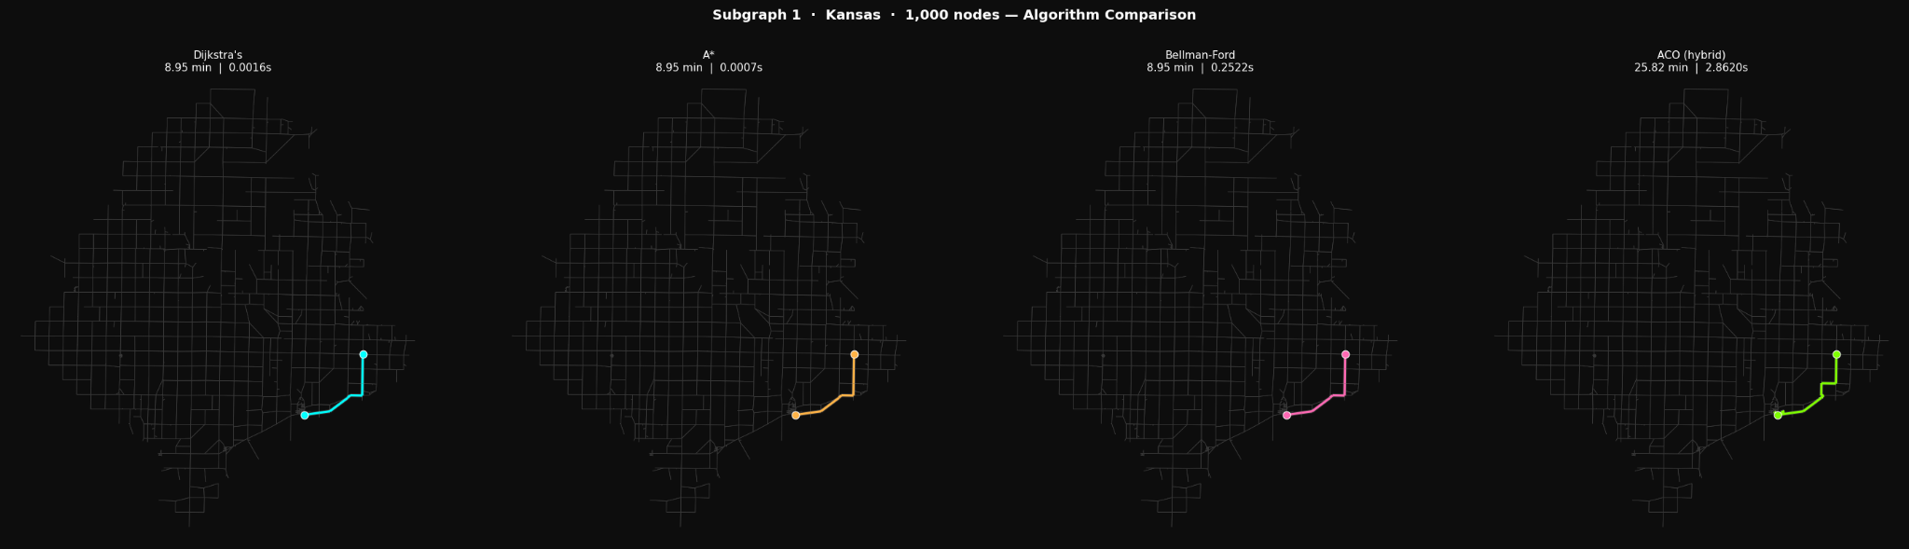
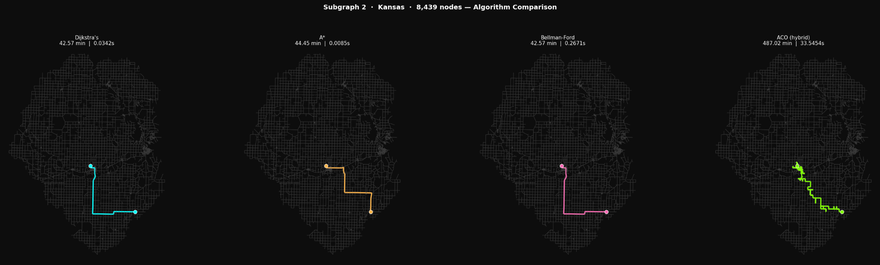
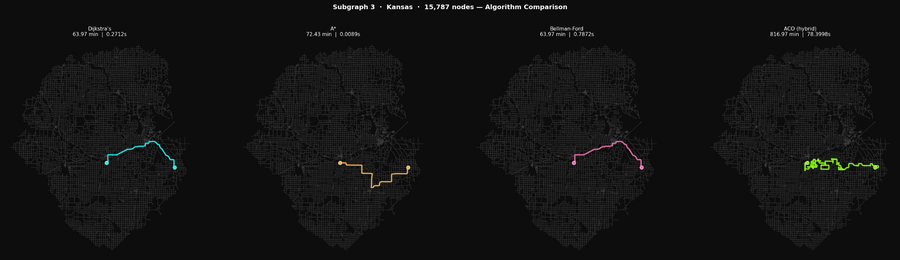
Algorithm Comparison

Slide 12
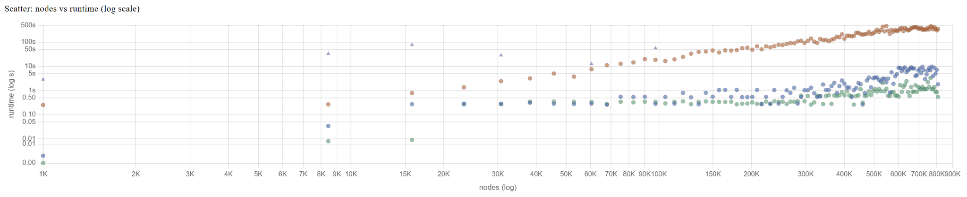
Algorithm Runtime Scalability
ACO and Bellman-Ford do not scale well at all.
A* and Dijkstra both scale well as graph size increases but if you are looking to have the most optimal runtime A* would work best.
If you are looking to have the most optimal path regardless of runtime, Dijkstra's the optimal algorithm.

Slide 13
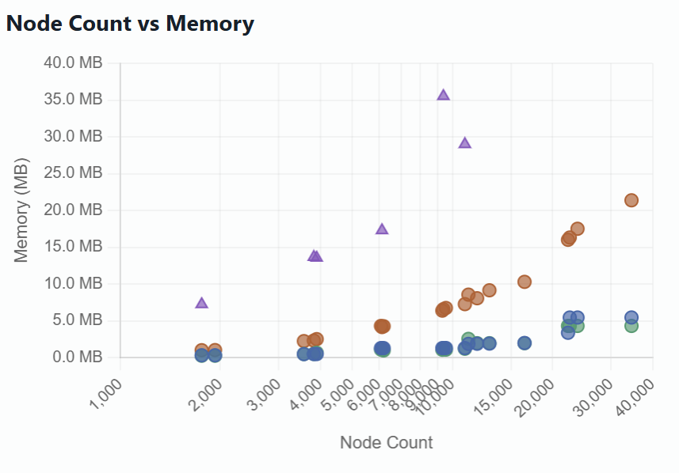
Algorithm Memory Scalability
ACO and Bellman-Ford do not scale well at all.
A* and Dijkstra both scale well as node size increases but overtime Dijkstra is shown to not be as memory efficient as A*.
When optimizing shortest pathfinding memory usage A* would be ideal. Otherwise Dijkstra’s would be ideal for its guaranteed shortest path.

Slide 14
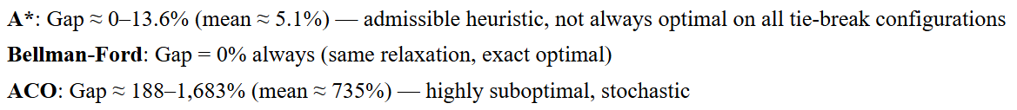
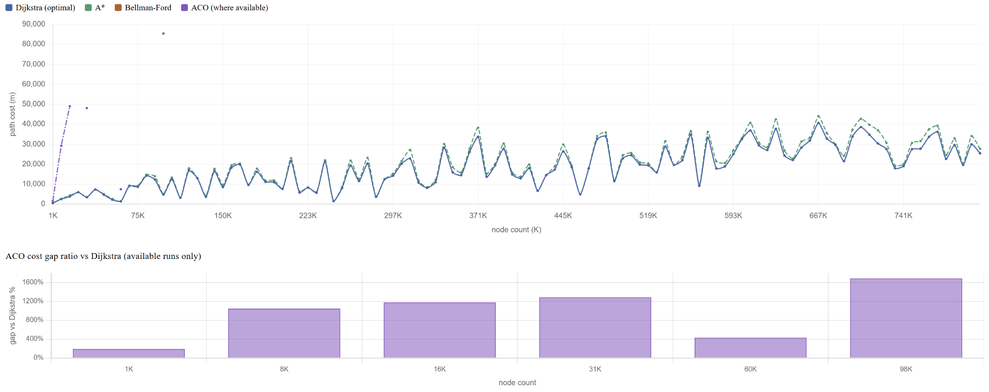
Optimizing Pathfinding
When only looking for the most optimal path Dijkstra’s Algorithm will always be best.
If you are in need to optimize runtime and memory usage this shows that the percent error A* compared to Dijkstra’s only even on larger graph sizes is at most 13.6% which for most use cases is a satisfactory result.

Slide 15
Findings
1
Dijkstra’s
2
A*
Dijkstra’s Algorithm has slightly worse time and memory optimality than A* but has guaranteed shortest path making it very optimal for most use cases unless working in super resource limited environments or ultra large graphs.
A* has best time and memory optimality but does not guarantee shortest path. It makes it optimal for resource limited environments or large datasets since its path cost gap from dijkstra is minimal.
3
Bellman-Ford
4
Ant-Colony Optimization
Bellman-Ford’s use case is best for graphs with negative edges which are not in OSM datasets that we are using making it not optimal due to its low runtime and exponential memory usage for shortest pathing in OSM road networks.
ACO has terrible time and memory optimality. It also does not guarantee a path. It is not optimal whatsoever when working on network routing optimization to find the shortest path in a OSM graph.

Slide 16
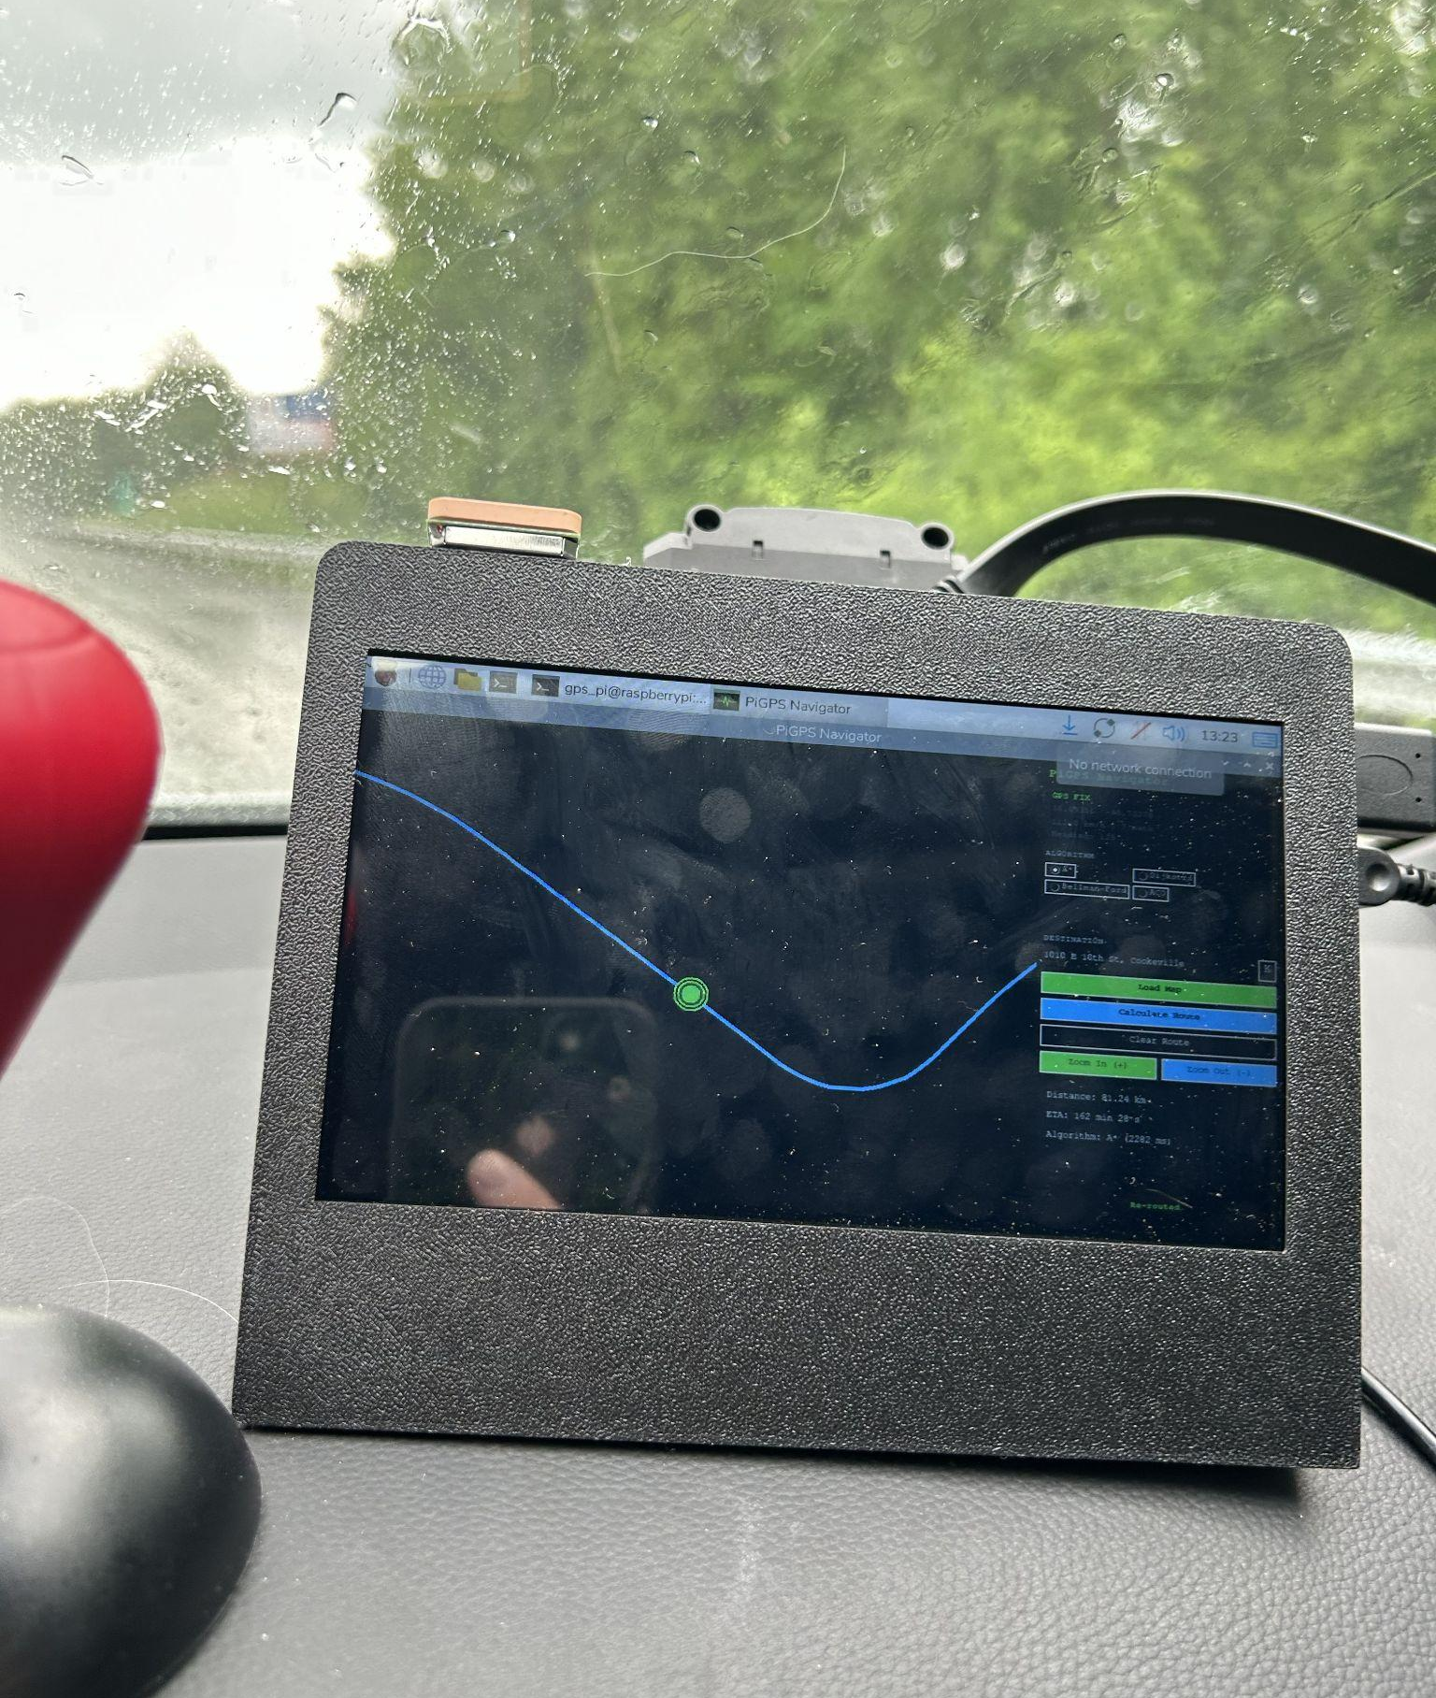
Real-World Application
GPS Routing
Device Specs
Shortest Path Algorithms such as specifically Dijkstra and A* play a large role in GPS Routing. It is imperative that such algorithms are able to ensure satisfactory routing that is both short as possible and quickly calculated in resource constrained environments (such as GPS Devices) which is able to be done by making sure they have conservative memory usage and maintaining efficient time efficiency.
Raspberry Pi Zero 2 W
Processor: 1GHz quad-core 64-bit Arm Cortex-A53 CPU
Memory: 512MB LPDDR2 SDRAM
Storage: 32GB microSD
Wireless: 2.4GHz IEEE 802.11b/g/n wireless LAN and Bluetooth 4.2 with BLE
NEO-6M GPS Module
20V Hyper Tough Drill Battery
7in 1024x600p Touchscreen LCD Display
MP1584 Buck Converter
470uF, 0.1uF Capacitors

Slide 17
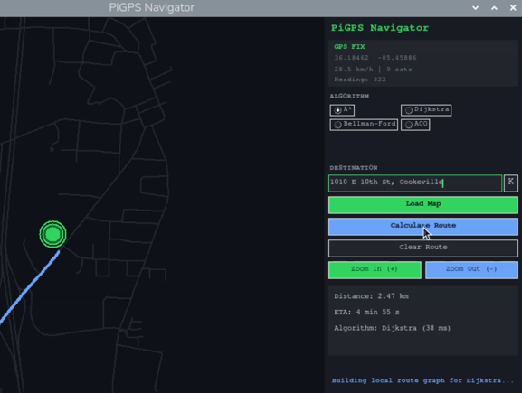
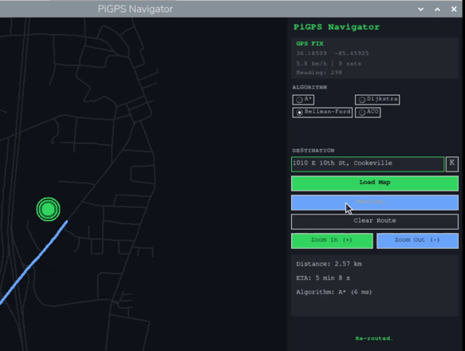
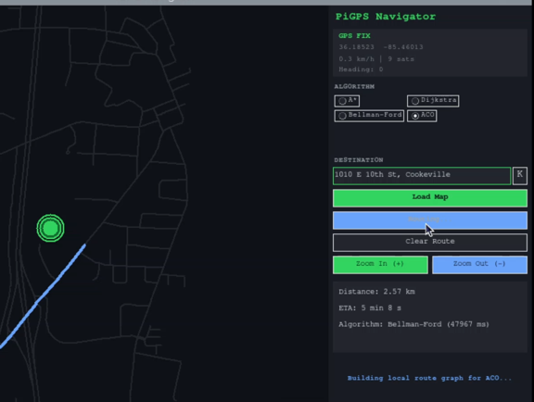
Pathing Within Cookeville
Algorithm: Dijkstra’s
Distance: 2.47km
ETA: 4 min 55 s
Runtime: 38ms
Algorithm: A*
Distance: 2.57km
ETA: 5 min 8 s
Runtime: 6ms
Algorithm: Bellman-Ford
Distance: 2.57km
ETA: 5 min 8 s
Runtime: 47967ms == 47.967s
Algorithm Application
On smaller datasets such as Cookeville. Dijkstra and A* algorithms are easily applicable for GPS Routing in resource constrained environments as they do not take up much memory and are virtually equal in time efficiency in this context.
Algorithm: Ant Colony Optimization (NO PATH FOUND)

Slide 18
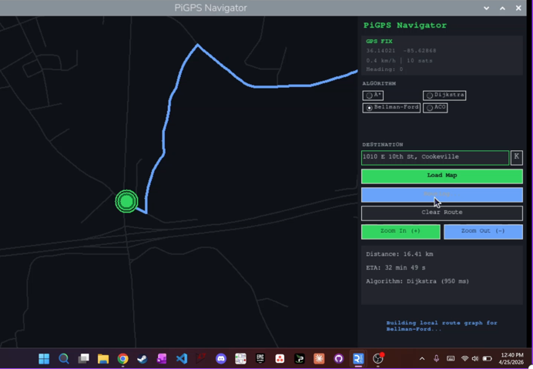
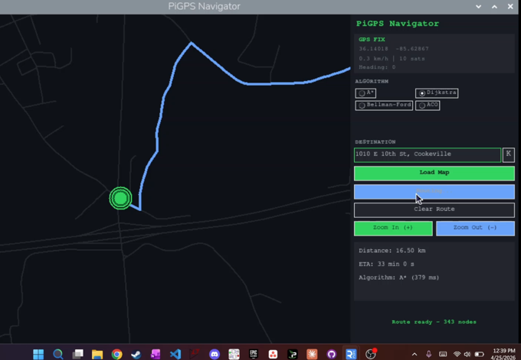
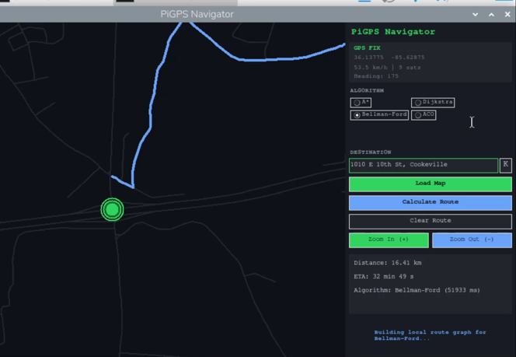
Pathing Near Cookeville
Algorithm: Dijkstra’s
Distance: 16.41km
ETA: 32 min 49 s
Runtime: 950ms
Algorithm: A*
Distance: 16.50km
ETA: 33 min 0 s
Runtime: 379ms
Algorithm: Bellman-Ford
Distance: 16.41km
ETA: 32 min 49 s
Runtime: 51933ms == 51.933s
Algorithm Application
As the dataset increases Bellman-Ford and ACO stay irrelevant, but A* and Dijkstra stay very useful for being applied for GPS Routing in resource constrained environments. With that being said it is here you can see noticeable drop in time efficiency for Dijkstra’s.
Algorithm: Ant Colony Optimization (NO PATH FOUND)

Slide 19
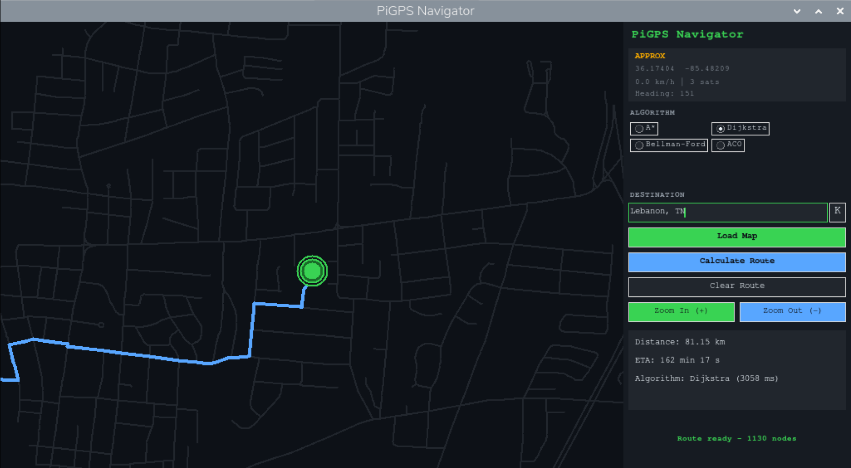

Pathing Cookeville to Lebanon
Algorithm: Dijkstra’s
Distance: 81.15km
ETA: 162 min 17 s
Runtime: 3058ms
Algorithm: A*
Distance: 81.15km
ETA: 162 min 17 s
Runtime: 2814ms
Algorithm Application
As the dataset increases even further Dijkstra lags behind A* in time efficiency. Bellman-Ford and ACO take too much RAM to be ran on any large dataset, but Dijkstra and A* stay very viable options for doing GPS Routing on resource constrained environments. At this point graph/subgraph loading becomes the main slowdown.
Algorithm: Bellman-Ford (PATH TOO FAR)
Algorithm: Ant Colony Optimization (PATH TOO FAR)

Slide 20
GPS Pathfinding Optimization
1
Prerequisites
2
Graph Optimizations
To run this program requires a relatively intensive configuration to have the correct packages and hardware configuration for all software and connected hardware.
The most intensive optimization when it comes to GPS Routing is Graph Loading. When memory is limited you can not load large graphs into memory. This requires you to load a large graph in smaller subgraphs and cache them to be able to used with algorithms without overloading the devices memory.
3
Software Optimizations
4
Hardware Optimizations
To help with preventing overloading memory set the device to have 1GB of swap memory encase the 512MB memory is overloaded during any processes.
Due to time/money constraints I had to optimize my program around the abilities of the connected hardware and its downsides. Such as the NEO-6M only giving moderately reliable coordinates.

Slide 21
GPS - Algorithm Applicability
Dijkstra’s
Dijkstra Guarantee a shortest path while also having good time efficiency and has no memory usage issues in memory constrained environments. In the majority of graphs besides ultra large paths Dijkstra’s is the perfect algorithm to implement for GPS Routing.
A*
A* while it does not Guarantee the shortest path it has the best time efficiency and memory usage. This is incredibly important for low power GPS devices that may have very limited hardware. This would make A* the best choice to implement since it still keep very similar/equal paths to dijkstra’s
Bellman-Ford
Bellman-Ford while useful if there is negative edges road networks have virtually none. Due to this Bellman-Ford becomes useless for GPS Routing due to its high computation time and high memory usage
Ant Colony Optimization
Ant Colony Optimization is not good in road networks as well due to the ants gettings often stuck long amount of cycles in road networks. It also has high computation time and memory usage making it not applicable to GPS Routing.
Conclusion
Dijkstra is the most applicable to GPS Routing in most cases unless the hardware is incredibly constrained or need to do lots of cross country routing, A* will be the most applicable algorithm.

Slide 22
The End

